Slide 1
Predict Survival of patients with heart failure
Raúl Lizardo
Data Scientist

Slide 2
Simple approach
I explore the dataset provided by [1] and implement a straightforward Logistic Regression Classifier to predict heart failure. Next, I compare three different models: Dummy Classifier, Simple Logistic Regression and Logistic Regression with interaction terms to confirm if the interaction term improves the model.
I chose to improve a simple model instead of using more complex ones because real-world applications require building simple models first, which serves as a foundation for creating a robust and functional model
[1] BMC Medical Informatics and Decision Making 20, 16 (2020)

Slide 3
Dataset
This dataset contains the information on 299 patients with heart failure, collected in 2015, including those who died during the follow-up period. The dataset has the following features:
Feature | Explanation | Measurement | Range
Age | Age of the patient | Years | [40, 95]
Anaemia | Decrease of red blood cells or hemoglobin | Boolean | 0, 1
High blood pressure | If a patient has hypertension | Boolean | 0, 1
Creatinine phosphokinase (CPK) | Level of the CPK enzyme in the blood | mcg/L | [23, 7861]
Diabetes | If the patient has diabetes | Boolean | 0, 1
Ejection fraction | Percentage of blood leaving the heart at each contraction | Percentage | [14, 80]
Sex | Woman or man | Binary | 0, 1
Platelets | Platelets in the blood | kiloplatelets/mL | [25.01, 850.00]
Serum creatinine | Level of creatinine in the blood | mg/dL | [0.50, 9.40]
Serum sodium | Level of sodium in the blood | mEq/L | [114, 148]
Smoking | If the patient smokes | Boolean | 0, 1
Time | Follow-up period | Days | [4,285]
(target) death event | If the patient died during the follow-up period | Boolean | 0, 1

Slide 4
Stratifying the dataset
Before of construct the model, I stratified the data to stay away of a skew vision.
There are many ways to stratified the data (e.g. by age, time, boolean features, etc. ). I decide to stratified by each possible combination of boolean features. However, when I split the dataset, into training (80%) and testing (20%) data, some combinations do not have the enough size to be split. I treat these combination as outliers and remove it.
Boolean Features:
Anaemia
High blood pressure
Diabetes
Sex
Time

Slide 5
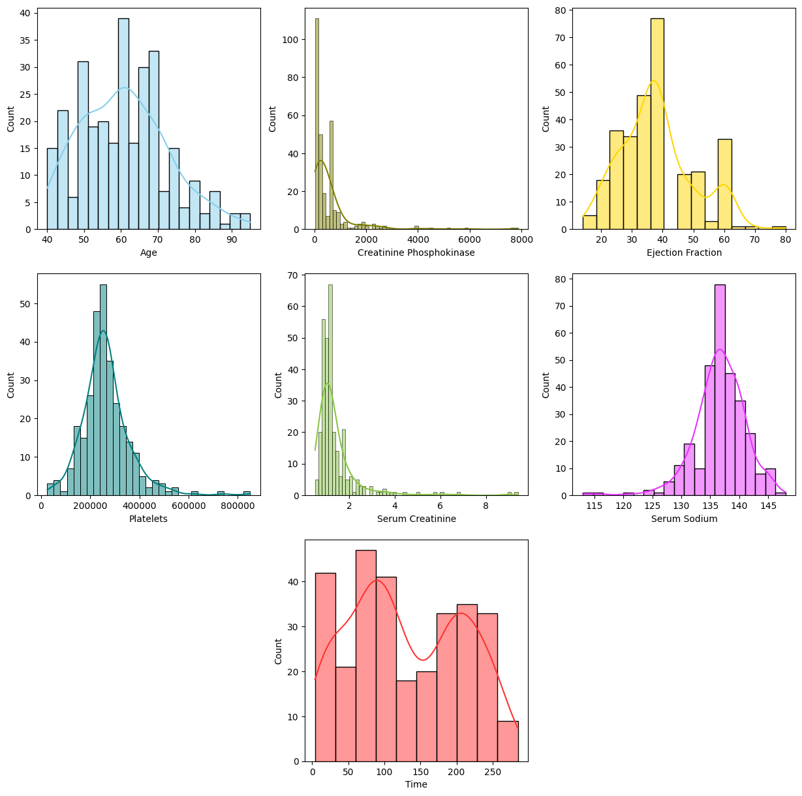
Numerical Features Histograms
Platelets and Serum Sodium are normally distributed.
Creatinine Phosphokinase and Serum Creatinine have log-normal distribution. A log transformation is needed in the preprocessing step.
Age, Ejection Fraction and Time follow a multimodal distribution. I employ a cluster similarity approach, based on k-means, for a normal similarity function of each mode in the original distribution.

Slide 6
Feature Selection

Slide 7
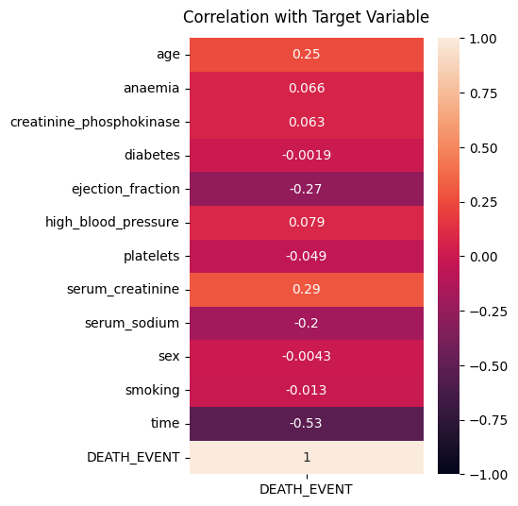
Correlation with the target variable.
I select the predictor variables with correlation c between the target variable, which have more than 0.1 or less than -0.1. The chosen variables are:
Age
Ejection Fraction
Serum Creatinine
Serum sodium
Time

Slide 8
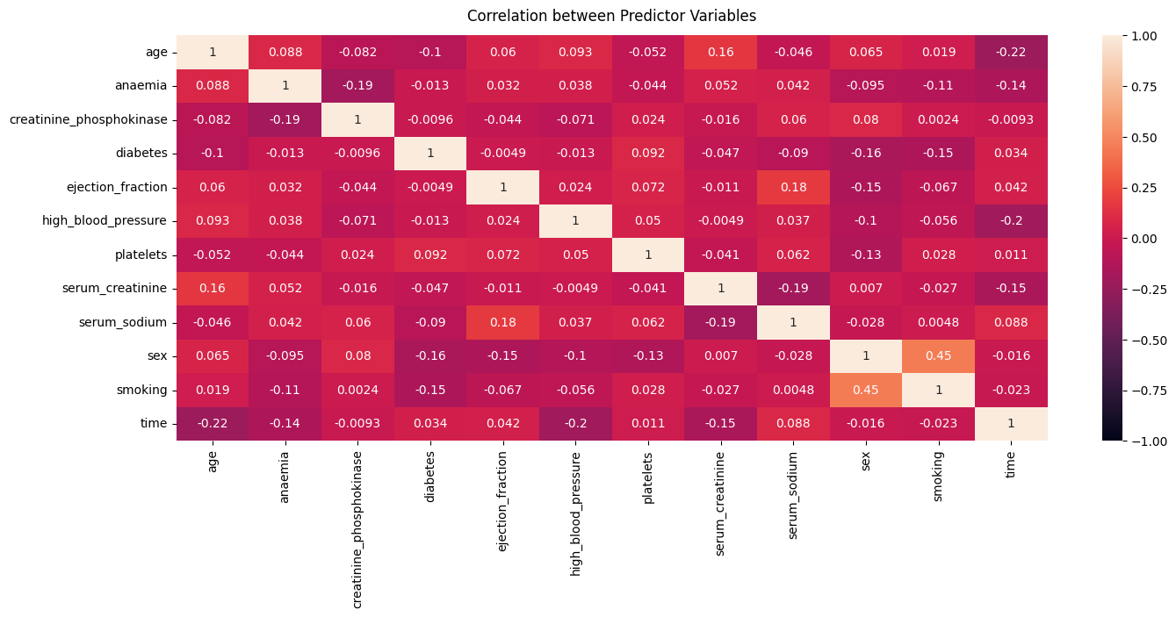
Correlation between Predictor Variables
Age and Time have important correlation with the Target Variable, their interaction term should be equally important.
In otherwise, High Blood Pressure, sex and smoking have been showed low correlation with Death Event. However, their interaction terms should be analyzed if they are worthy of be adding to the model.

Slide 9
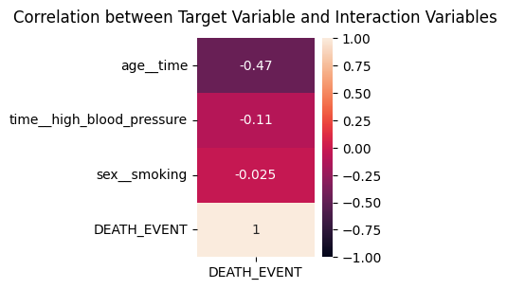
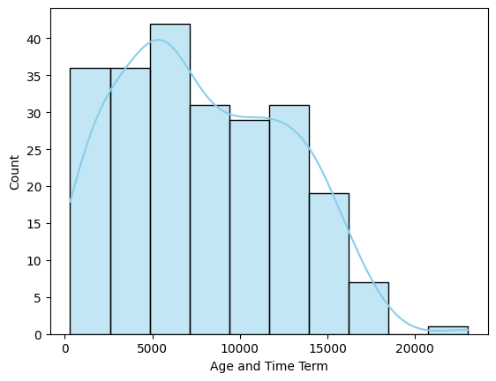
Interactions Terms
As I mentioned before, it is necessary to add a interaction term between Age and Time. However, the remaining interaction terms do not have a enough correlation to justify its adding in the model.
Also, this new added feature follow a multimodal distribution.
I use these interaction in the improved model.

Slide 10
Preprocessing Pipeline
I use three different pipelines to construct different models.
Dummy Classifier: It is the simplest pipeline. I only use DummyClassifier from Scikit with the stratified strategy.
Simple Logistic Regression (Simple Model). Here I apply log transformation, standardization and cluster similar in the seen most importance features in the correlation matrix.
Logistic Regression with Interaction Term (Interaction Model): In the Simple Model pipeline, I add the interaction term between Age and Time.

Slide 11
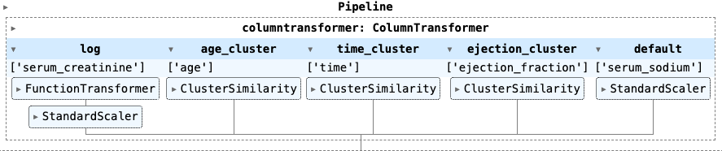
Pipeline - Simple
Logistic Regression
The most important predictor variables are:
Age
Ejection Fraction
Serum Creatinine
Serum sodium
Time
Serum Sodium: I apply a straightforward Standardization because the Logistic Regression is sensitive to the magnitude of the predictor variables.
Serum Creatinine: Before standardization, I log transform the variable due to this variable presents a left-skewed distribution.
Age, Time & Ejection Fraction: These variables have a multimodal distribution, then I use a Class, which is defined in [2], that compares the similarity of the values across different modes where each mode have a normal distribution with a width γ.

Slide 12
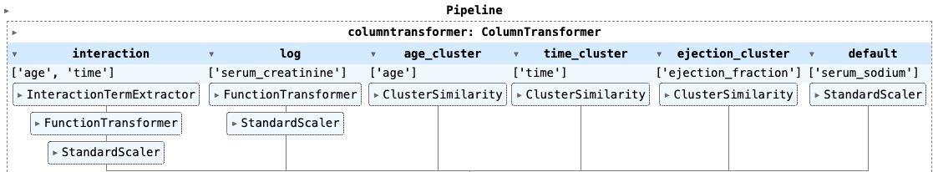
Pipeline - Logistic Regression with Interaction
Added Term: Interaction Between Age and Time
Interaction between Age & Time: After creating the interaction term by multiplying the Age and Time features, I log-transform the variable and then standardize it.

Slide 13
Hyperparameter Tuning

Slide 14
Hyperparameter Tuning - Simple Logistic Regression
 | Cluster Similarity
Variable | Number of Clusters | Width
Age | 1 | 0.53
Time | 10 | 0.21
Ejection Fraction | 12 | 0.21
I search the best hyperparameters for the Simple Model. The adjusted hyperparameters are:
Number of clusters and the width of each normal distribution for the modes of the variables Age, Time and Ejection Fraction.
Also I use a Ridge Regularization to avoid a plane Logistic Regression.
C (Ridge Regularization) | 0.77

Slide 15
Hyperparameter Tuning - Logistic Regression with Interaction
 | Cluster Similarity
Variable | Number of Clusters | Width
Age | 9 | 0.72
Time | 9 | 0.24
Ejection Fraction | 9 | 0.78
The same hyperparameters are tuned in the Interaction Model.
C (Ridge Regularization) | 0.78

Slide 16
Model Selection

Slide 17
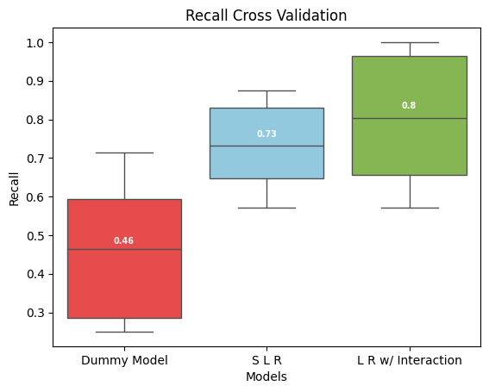
Model Selection - Cross Validation
I chose recall as the metric because minimizing false negatives is crucial. It would be catastrophic if the model incorrectly classifies a positive case as negative, leading to a patient's death shortly after.
After hyperparameter tuning the Simple and Interaction models (using 15-fold cross-validation with 500 iterations), I computed the recall using 10-fold cross-validation.
I conclude that Interaction Model is better 9.5% than Simple Model by its Recall median. However, I observe that Interquartile range is 40.4% larger in the Interaction Model (0.3) than Simple Model (0.18). This suggests that while the Interaction Model tends to perform better than the Simple Model in half the cases but its performance is more variable.

Slide 18
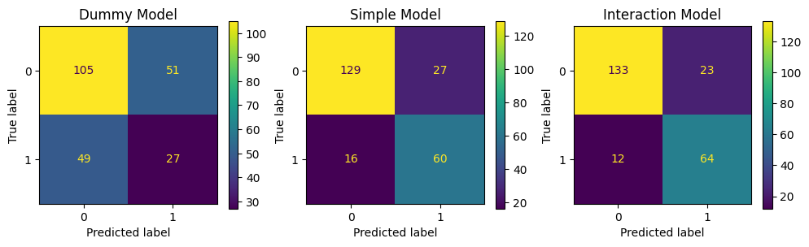
Model Selection - Confusion Matrix
It is evident that the Interaction Model identifies more true cases than all other models, achieving a precision of 73% and a recall of 84%. The F1-score for the Interaction Model is 78.5%.

Slide 19
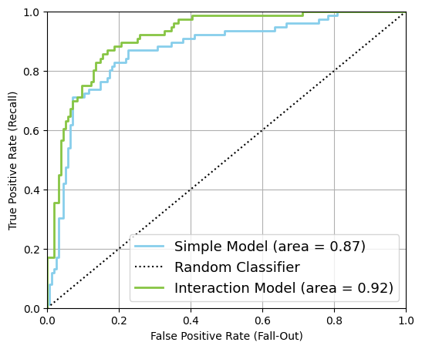
Model Selection - ROC Curve
Finally, the AUC score confirms that the Interaction Model is indeed better than the Simple Model. I justify this selection because the Interaction Model's AUC (0.92) is 5.7% higher than that of the Simple Model (0.87).

Slide 20
Model Selection - Coefficients
Predictor Variable | Coefficient in Logistic Regression
interaction__age time | -1.39
time_cluster__Cluster 7 similarity | -1.05
ejection_cluster__Cluster 2 similarity | -0.78
ejection_cluster__Cluster 6 similarity | -0.77
time_cluster__Cluster 1 similarity | -0.60
age_cluster__Cluster 6 similarity | -0.58
time_cluster__Cluster 5 similarity | -0.53
time_cluster__Cluster 6 similarity | -0.48
age_cluster__Cluster 4 similarity | -0.41
age_cluster__Cluster 2 similarity | -0.41
ejection_cluster__Cluster 7 similarity | -0.36
age_cluster__Cluster 5 similarity | -0.34
time_cluster__Cluster 3 similarity | -0.33
time_cluster__Cluster 4 similarity | -0.33
ejection_cluster__Cluster 3 similarity | -0.25
default__serum_sodium | -0.22
age_cluster__Cluster 1 similarity | -0.15
ejection_cluster__Cluster 1 similarity | -0.07
time_cluster__Cluster 8 similarity | -0.03
ejection_cluster__Cluster 4 similarity | 0.00
age_cluster__Cluster 8 similarity | 0.07
age_cluster__Cluster 0 similarity | 0.09
age_cluster__Cluster 3 similarity | 0.13
time_cluster__Cluster 2 similarity | 0.21
time_cluster__Cluster 0 similarity | 0.2
ejection_cluster__Cluster 5 similarity | 0.3
age_cluster__Cluster 7 similarity | 0.4
log__serum_creatinine | 0.8
ejection_cluster__Cluster 0 similarity | 1.1
ejection_cluster__Cluster 8 similarity | 1.2
The most significant variable is the interaction term between Age and Time. This suggests that as both Age and Time (the follow-up period) increase, the probability of heart failure decreases. It is advisable for patients to visit the doctor frequently for monitoring.
Additionally, certain clusters of Age, Time, and Ejection Fraction are relevant in the regression. Specifically, clusters 0 (minimum value) and 8 (maximum value) of the Ejection Fraction variable have positive coefficients, indicating that either an excess or lack of blood pressure leaving the heart increases the probability of heart failure."

Slide 21
Interaction Model in Test Data Set

Slide 22
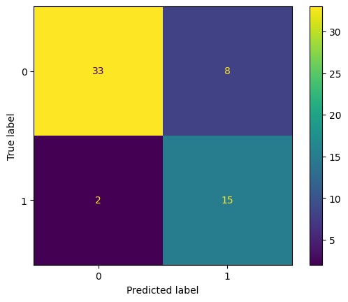
Model Selection - Confusion Matrix
The Interaction Model on has a precision of 65.2% and a recall of 88.2%. The F1-score is 75.1% that is less score than train set.

Slide 23
Conclusions:
I applied a Dummy Classifier and a Simple Logistic Classifier (Simple Model) with appropriate feature selection and preprocessing, including log transformation, standardization, and handling of multimodal distributions. The Simple Model achieves a recall of 73% via cross-validation.
I added a interaction term between Age and Time in the Logistic Regression This new model (Interaction Model) obtain a 80% of Recall. In the entire training dataset, it represents 4 more correct diagnoses of individuals who could survive.
In the test dataset, the final recall is 88%. This demonstrates that adding a term can enhance model performance without the need for more complex models.

